Slide 1
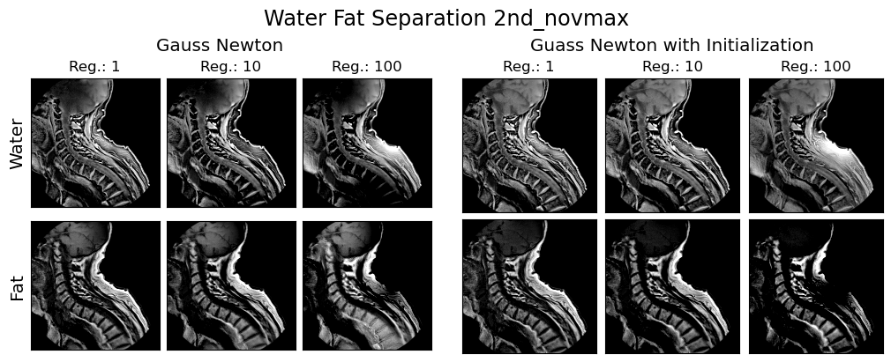
Robust single-point ultra short echo time water-fat separation
By: Mateo Argudo
Before
After

Slide 2
Motivation
Overview
Motivation of imaging short T₂ species
Previous efforts on imaging tissues containing short T₂ components
Ultra short echo time (UTE) techniques
Water-fat separation
Notes:
First we will present the motivation on why do we use sUTE-Dixon. And we will talk about why do we want to model the field inhomogeneities to achieve a better water fat separation quality.

Slide 3
Motivation
The most effective strategy to diagnose parenchymal disease with MRI is to detect abnormal tissue using heavily T₂ weighted pulses¹
Main diagnostic emphasis remains on imaging tissues with long T₂*
2018, Brooks J. MRI background parenchymal enhancement, breast density and serum hormones in postmenopausal women. J. Cancer.
2003, Robson, M. Magnetic Resonance: An Introduction to Ultrashort TE (UTE) Imaging, Journal of Computed Assisted Tomography

Slide 4
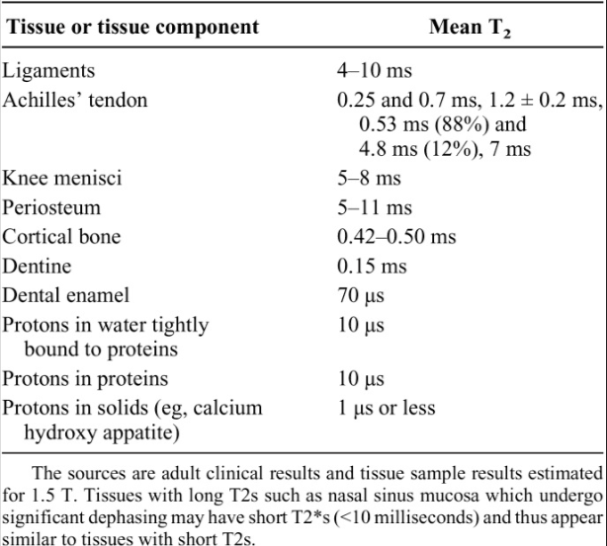
Motivation
Short T₂* tissues such as cortical bone provide a useful background against which to recognize abnormalities that produce an increase of a signal
Because of the absence of signal its difficult to image it properly
2018, Brooks J. MRI background parenchymal enhancement, breast density and serum hormones in postmenopausal women. J. Cancer.
2003, Robson, M. Magnetic Resonance: An Introduction to Ultrashort TE (UTE) Imaging, Journal of Computed Assisted Tomography

Slide 5
Previous Efforts on Imaging Short T₂* Tissues
Imaging short T2 components is hard due to absence of signal
Using spin echo sequences with TE=10-20 ms, tissues with T₂s > 10ms are detectable¹ e.g. Common Tissue
Gradient echo sequences with TE= 1-2 ms, detect tissues with T₂s = 1-2 ms¹ e.g. Ligaments, Menisci.
UTE have TE x100-1000 shorter and can be used to image tissue of the musculoskeletal system², e.g. cortical bone, calcium hydroxy apatite
2019 Hyungseok J. Fat suppression for ultrashort echo time imaging using a single-point Dixon method. NMR in Biomedicine.
2003, Robson, M. Magnetic Resonance: An Introduction to Ultrashort TE (UTE) Imaging, Journal of Computed Assisted Tomography

Slide 6
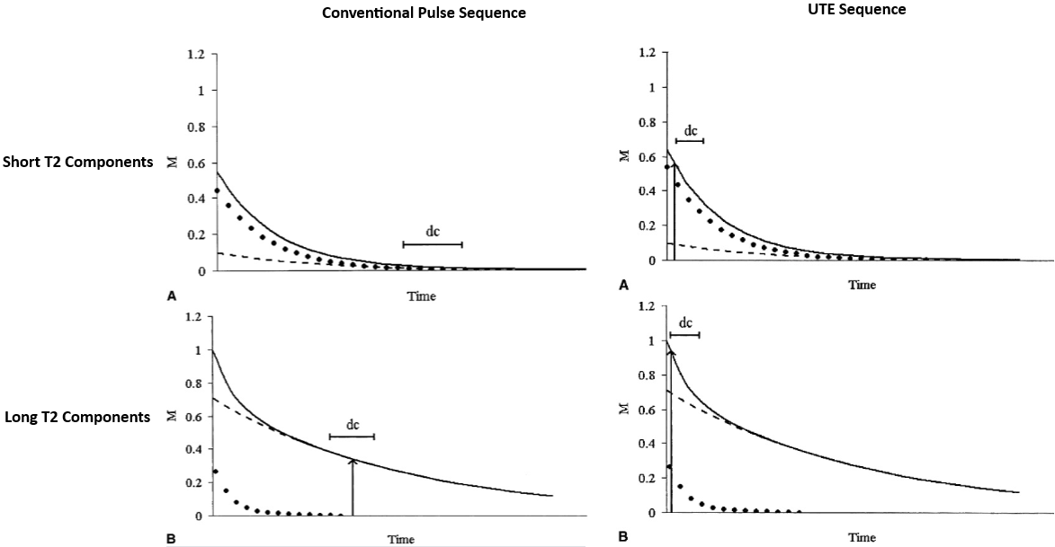
Imaging Short T₂* Tissues with UTE
↓ TE -> ↑ signal
DC: Readout
M: Signal Magnitude
2003, Robson, M. Magnetic Resonance: An Introduction to Ultrashort TE (UTE) Imaging, Journal of Computed Assisted Tomography

Slide 7
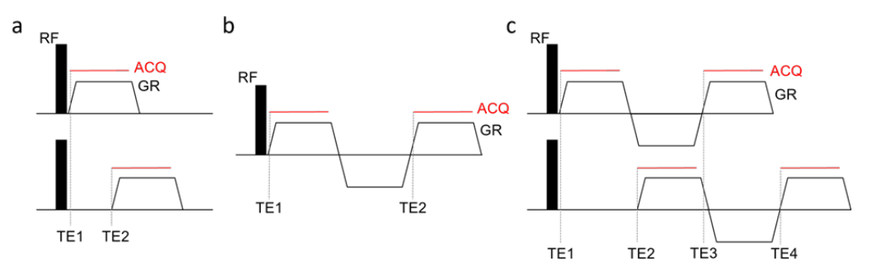
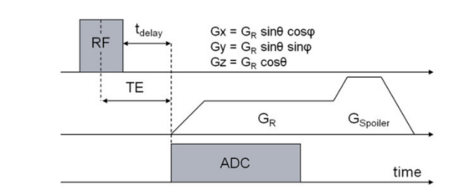
Mutli- vs Single-Echo UTE Sequences
Multi-Echo¹
Multi-echo sequences obtain contrast by comparing acquisitions at more than one TE
Have a high contrast to noise ratio (CNR)
Are effective for medium and long T₂ signal suppression
Single-Echo²
Single-echo UTE (sUTE) sequences obtain contrast directly from the first signal
Have shorter acquisition times but less CNR than multi-echo sequences
1. 2023 Kronthaler S, UTE-Dixon Water-Fat Imaging. MRI of short and ultrashort T2 tissues.
2. 2007 Nielles S, “Atherosclerotic Plaque Imaging with Ultra Short Echo Time (UTE) MRI. ISMRM

Slide 8
Suppressing Fat to Enhance Contrast
Fat contributes a significant MR signal in diagnostic imaging
Suppressing, separating fat/long-T₂ signals help improve short-T₂ tissues contrast
Water-fat separation is essential for^{1,2}:
Assessing metabolic disorders: obesity, metabolic syndrome, type-2 diabetes
Derive biomarkers: body fat distribution, proton density fat fraction (PDFF)
2016 Baum T. MR-based assessment of body fat distribution and characteristics. European Journal of Radiology.
1984, Dixon T. Simple proton spectroscopic imaging. Radiology

Slide 9
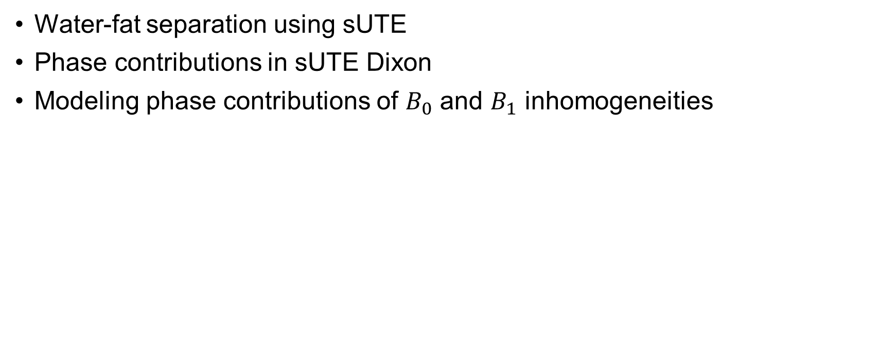
sUTE Dixon
Overview
Water-fat separation using sUTE
Phase contributions in sUTE Dixon
Modeling phase contributions of $B_{0}$ and $B_{1}$ inhomogeneities
Notes:
First we will present the motivation on why do we use sUTE-Dixon. And we will talk about why do we want to model the field inhomogeneities to achieve a better water fat separation quality.

Slide 10
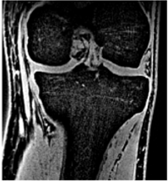
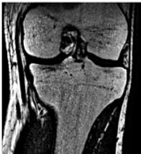
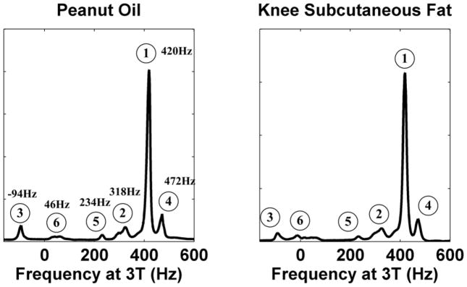
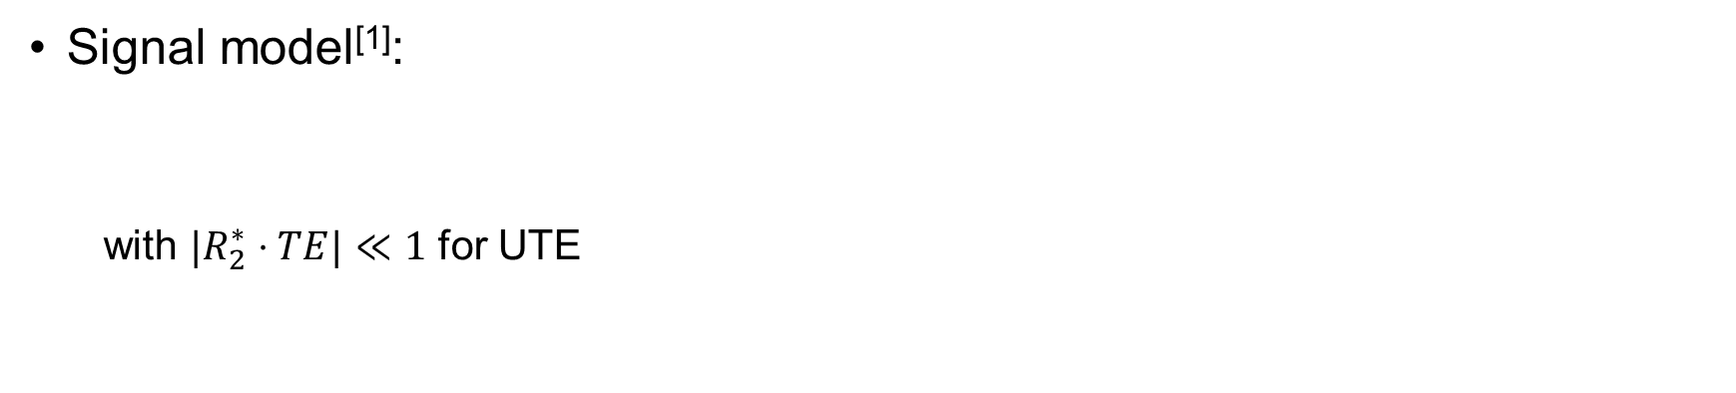
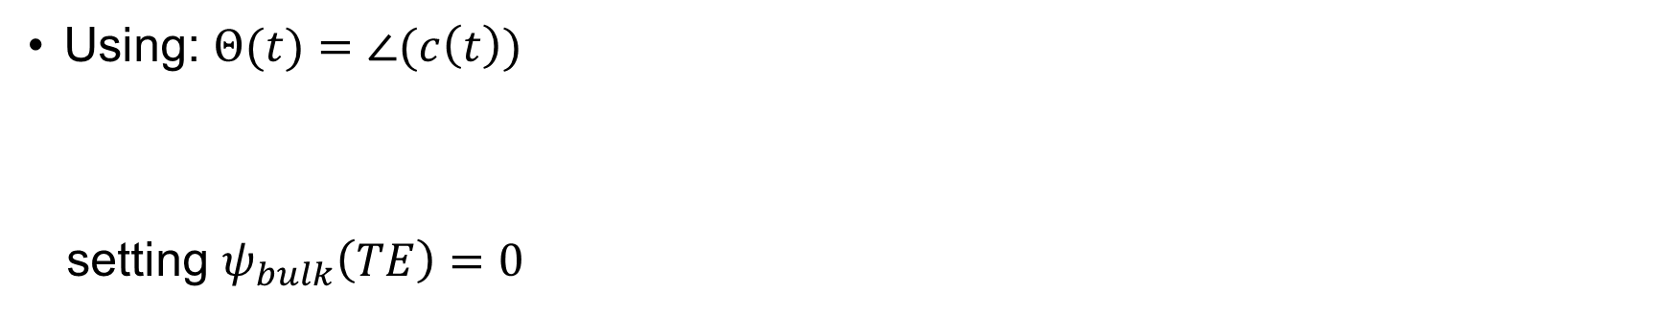
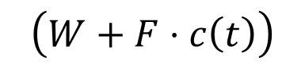
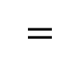
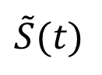
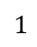
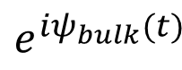
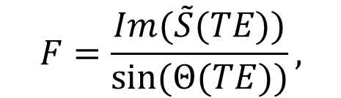
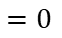
sUTE Water-Fat Separation
Signal model^{[1]}:
with ${|R}_{2}^{∗}⋅TE|≪1$ for UTE
Signal model^{[1]}:
$$1$$
!
$$=0$$
$$\tilde{S}(t)$$
$$=$$
$$e^{iψ_{bulk}(t)}$$
$$\left(W+F⋅c\left(t\right)\right)$$
$$\tilde{S}(t)={e^{{−R}_{2}^{∗}t}e}^{iψ_{bulk}(t)}\left(W+F⋅c\left(t\right)\right),$$
$$\tilde{S}(t)=e^{iψ_{bulk}(t)}\left(W+F⋅c\left(t\right)\right),$$
Using: $Θ(t)=∠(c\left(t\right))$
setting $ψ_{bulk}\left(TE\right)=0$
$$F=\frac{Im(\tilde{S}(TE))}{sin⁡(Θ(TE))},$$
$$W=Re\left(\tilde{S}(TE)\right)−F⋅\cos\left(Θ\left(TE\right)\right)$$
1. 2024 Kronthaler S, MRI of Short- and Ultrashort-T2 Tissues. Springer
2. 2008 Yu, Magn Reson Med 60:1122-1134

Slide 11
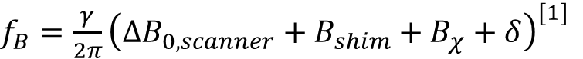
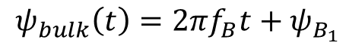
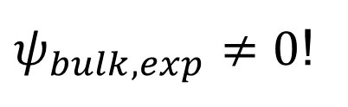
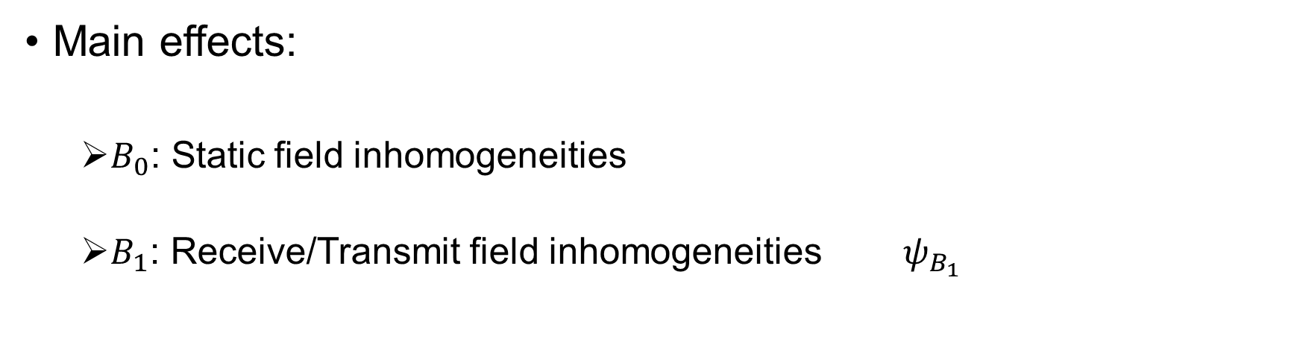
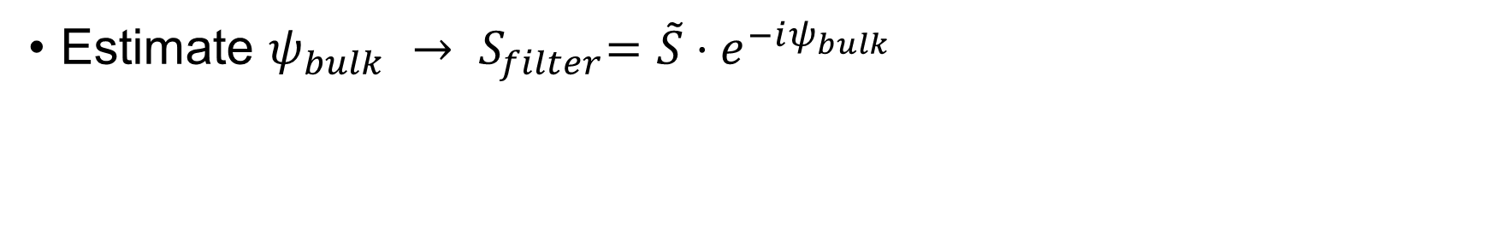
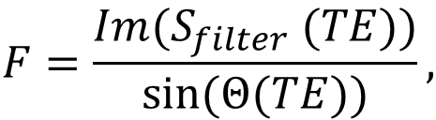
Phase Contributions in sUTE Dixon
$ψ_{bulk, exp}≠0$!
Estimate $ψ_{bulk} {→ S}_{filter}=\tilde{S}⋅e^{−iψ_{bulk}}$
$$F=\frac{Im(S_{filter} (TE))}{sin⁡(Θ(TE))},$$
$$W=Re\left(S_{filter} (TE)\right)−F⋅\cos\left(Θ\left(TE\right)\right).$$
Main effects:
$B_{0}$: Static field inhomogeneities
$B_{1}$: Receive/Transmit field inhomogeneities $ψ_{B_{1}}$
$$ψ_{bulk}\left(t\right)=2πf_{B}t+ψ_{B_{1}}$$
$f_{B}=\frac{γ}{2π}{\left(ΔB_{0, scanner}+B_{shim}+B_{χ}+δ\right)}^{[1]}$
1. 2018 Diefenbach MN Magn Reson Med. Sep;80(3):990-1004

Slide 12

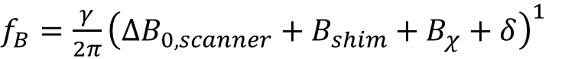
Modeling Phase Contributions $B_{0}$
B₀ inhomogeneities are global effects and are given by:
$f_{B}=\frac{γ}{2π}{\left(ΔB_{0, scanner}+B_{shim}+B_{χ}+δ\right)}^{1}$
The MR scanner inhomogeneities can be modeled by the sum of spherical harmonics (~polynomial) and are mostly lifted by the shim field B_{shim}:
${ΔB}_{0, scanner}=Σ_{l=1}^{L}Σ_{m=−L}^{L} C_{lm}Y_{lm}{\left(r,θ,φ\right)}^{2}.$
For the object induced inhomogeneities due to magnetic susceptibility we can use the dipole kernel approximation using the approximate field map of our tissue $χ\left(x,y,z\right)$:
$ψ_{χ}=−γB_{0}TE⋅F^{−1}\left[\left(\frac{1}{3} − \frac{k_{z}^{2}}{K^{2}}\right)⋅F(χ\left(x,y,z\right))\right].$³
2018 Diefenbach MN Magn Reson Med. Sep;80(3):990-1004
2021 Kronthaler S, Magn Reson Med. 2022; 87: 1771–1783
2009 Shumeli K, Magn Reson Med. 1510-1522.
Notes:
Short T₂* water and fat signals can be reconstructed from a single UTE complex image. (sUTE Dixon)

Slide 13

Modeling Phase Contributions $B_{1}$
The B₁ field inhomogeneity is a local effect
It generates from the transmitter/receiver field, depending on the connectivity of the tissue
Borders between distinctive tissues have high distortions due to $B_{1}$effects
Phase is locally smooth and slow varying with a polynomial envelope. Hence a polynomial fit may be used
2021 Kronthaler S, Magn Reson Med. 2022; 87: 1771–1783
2009 Shumeli K, Magn Reson Med. 1510-1522.
Notes:
Short T₂* water and fat signals can be reconstructed from a single UTE complex image. (sUTE Dixon)

Slide 14
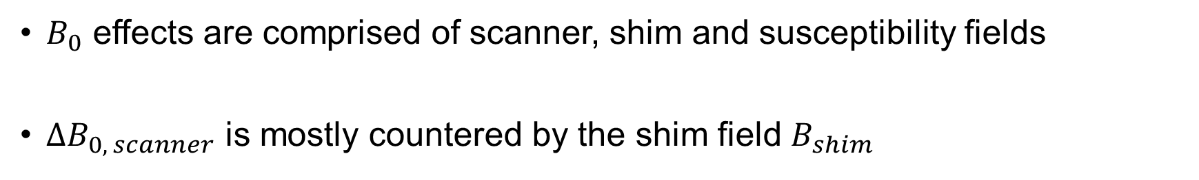
Key Takeaways
$B_{0}$ effects are comprised of scanner, shim and susceptibility fields
$ΔB_{0, scanner}$ is mostly countered by the shim field $B_{shim}$
$B_{0}$ effects may be modeled using the dipole kernel approximation for $B_{χ}$
$B_{1}$ effects are smooth and have a characteristic polynomial envelope
$B_{1}$ inhomogeneities may modeled using a 2nd Degree 3D polynomial
Notes:
Short T₂* water and fat signals can be reconstructed from a single UTE complex image. (sUTE Dixon)

Slide 15
Measuring phase contributions
Overview
The experiment
Qualitative assessment of induced phase contributions
Validation of modeling assumptions
Qualitative and quantitative assessment of modeled contributions
Notes:
First we will present the motivation on why do we use sUTE-Dixon. And we will talk about why do we want to model the field inhomogeneities to achieve a better water fat separation quality.

Slide 16
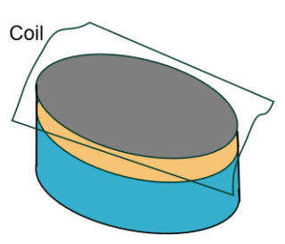
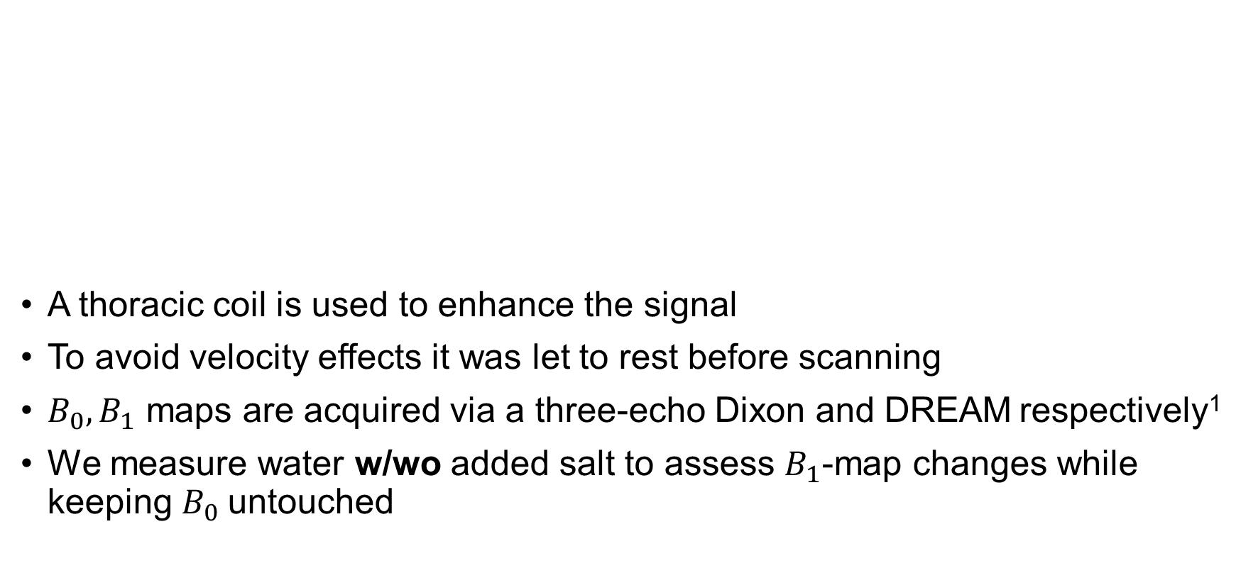
Measuring Phase Contributions
A thoracic coil is used to enhance the signal
To avoid velocity effects it was let to rest before scanning
$B_{0}, B_{1}$ maps are acquired via a three-echo Dixon and DREAM respectively¹
We measure water w/wo added salt to assess $B_{1}$-map changes while keeping $B_{0}$untouched
Fat
1x
3x
Water
2012 Nehrke k, Magn Reson Med. 2022; 87: 1517-1526
Notes:
Short T₂* water and fat signals can be reconstructed from a single UTE complex image. (sUTE Dixon)

Slide 17

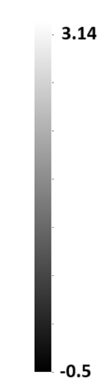
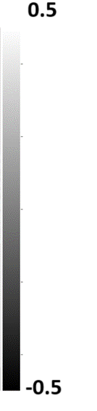
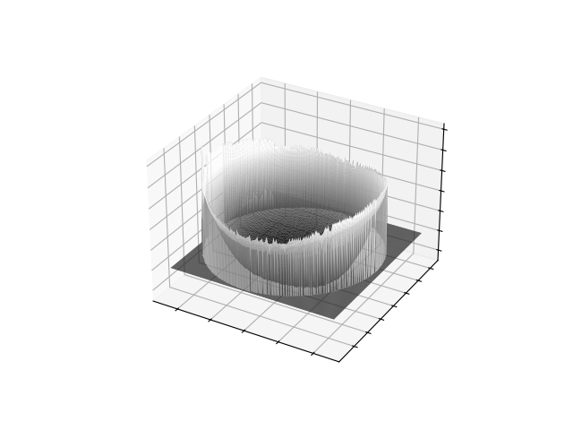

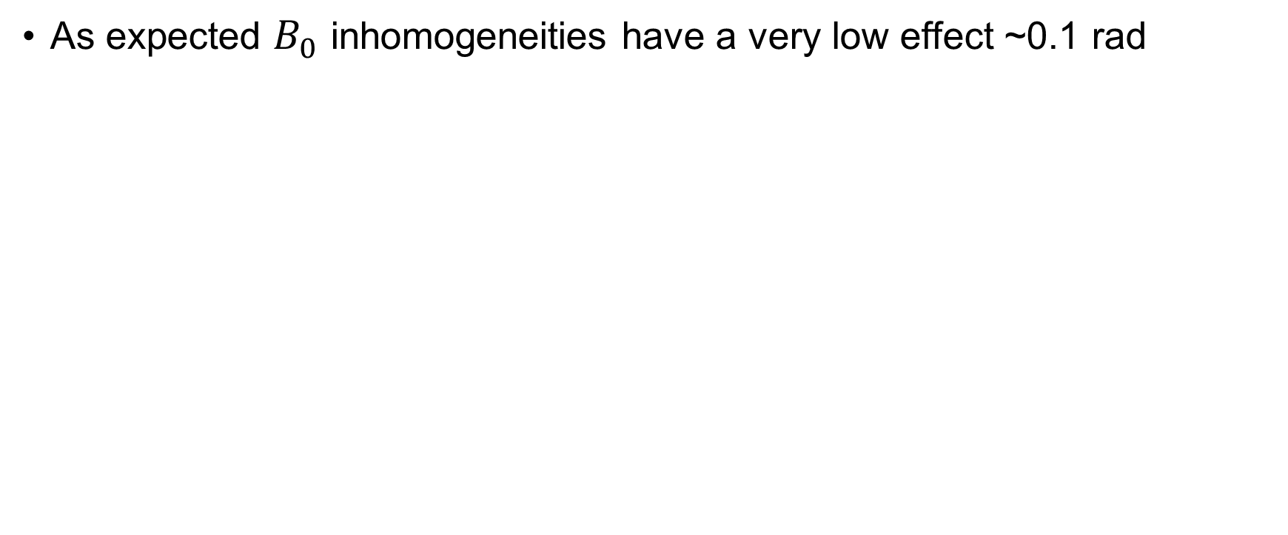
Assessing the Induced Phases Qualitatively
As expected $B_{0}$ inhomogeneities have a very low effect ~0.1 rad
$B_{1}$inhomogeneities are smooth and have a polynomial envelope
UTE phase w. salt
B₀ induced phase
UTE phase contour w. salt

Slide 18
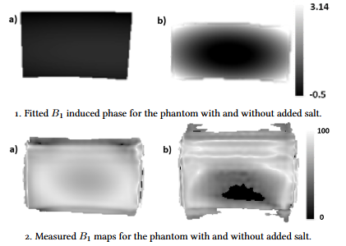
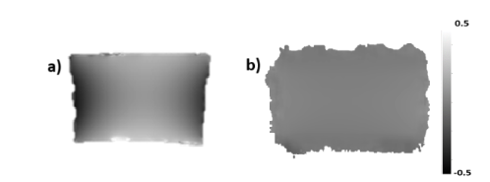
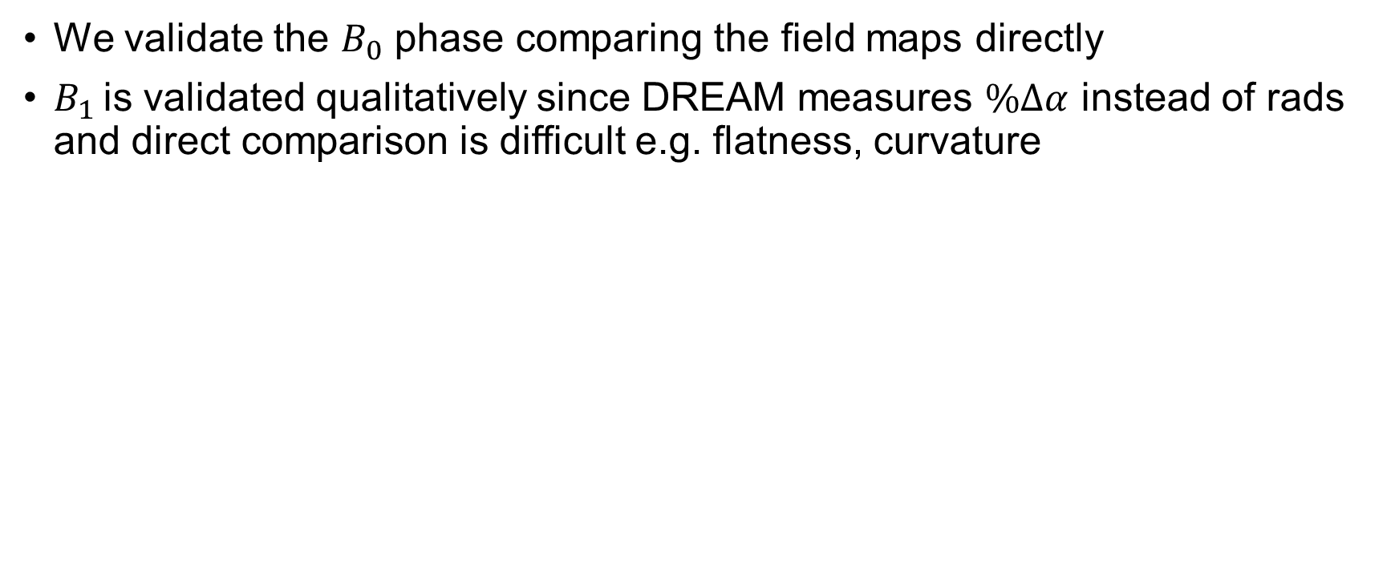
Validating the Modeled Phases
We validate the $B_{0}$ phase comparing the field maps directly
$B_{1}$ is validated qualitatively since DREAM measures $\%Δα$ instead of rads and direct comparison is difficult e.g. flatness, curvature
B₀ induced phases a) modeled b) measured

Slide 19
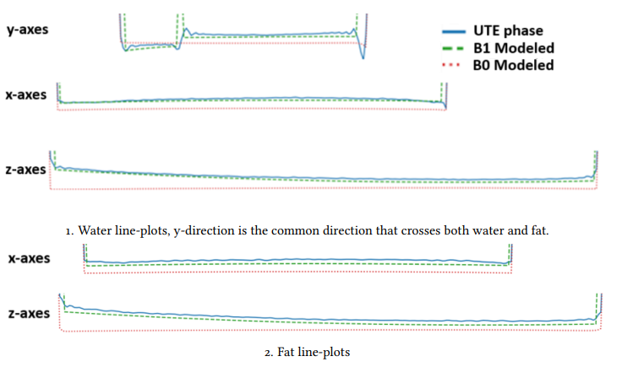
Assessing the Modeled Phases Qualitatively
Line-plots no salt
The B₁ modeled phase can adapt to the slight curvature of the phase inside the phantom
The B₀ modeled contribution cannot fit the raw phase correctly.

Slide 20
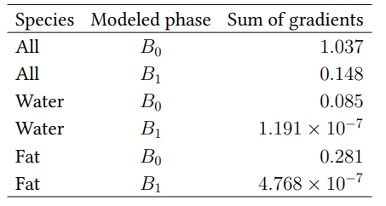
Assessing the Modeled Phases Quantitatively
Fat
Water
Fat Mask
Water Mask
Flatness Measurements
The flatness of the resulting phase after removing the respective modeled effect was measured via sum of gradients
Respective masks were chosen for measurements in water and fat species exclusively
The effect of B₁ inhomogeneities is proven to be much stronger than the B₀ counterpart

Slide 21
Key Takeaways: Modeling Phase Contributions
Salt induces higher conductivity changing phase to resemble a polynomial
The modeling approaches for $B_{0}$ and $B_{1}$ are validated with the reference scans
$B_{0}$ effects are low in magnitude and contribute less signal than $B_{1}$
$B_{1}$ contributions are qualitatively and quantitatively more relevant in UTE than $B_{0}$ effects
Notes:
Short T₂* water and fat signals can be reconstructed from a single UTE complex image. (sUTE Dixon)

Slide 22
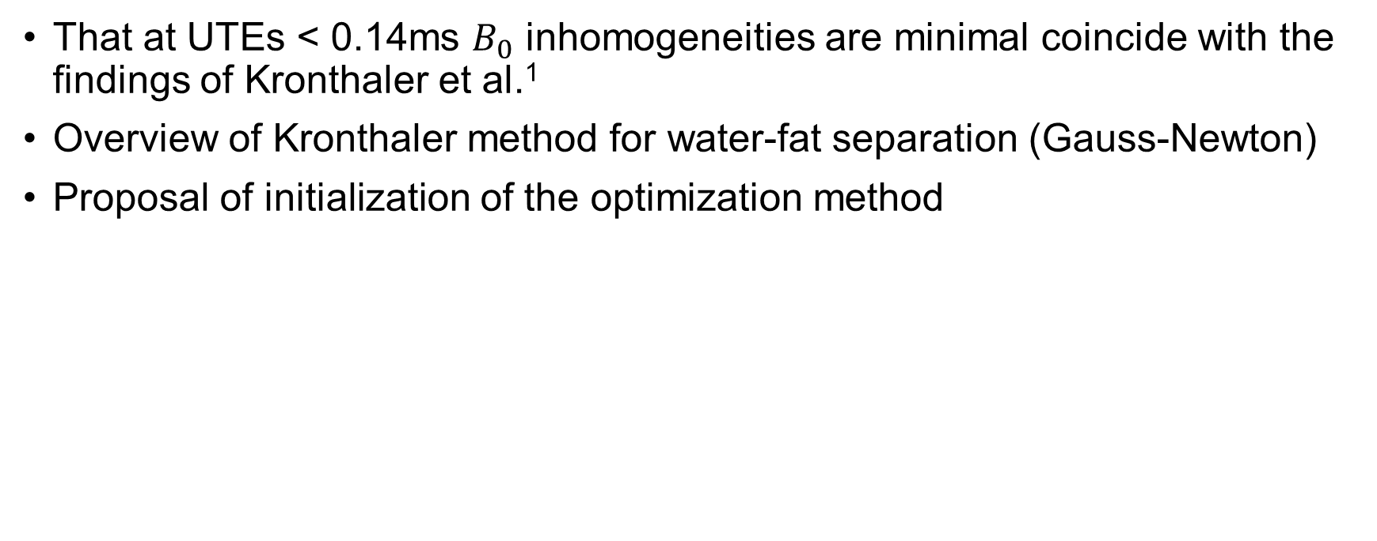
Initializing the Gauss-Newton Method
Overview
That at UTEs < 0.14ms $B_{0}$ inhomogeneities are minimal coincide with the findings of Kronthaler et al.¹
Overview of Kronthaler method for water-fat separation (Gauss-Newton)
Proposal of initialization of the optimization method
1. 2022 Kronthaler S, Magn Reson Med.; 87: 1771–1783.

Slide 23
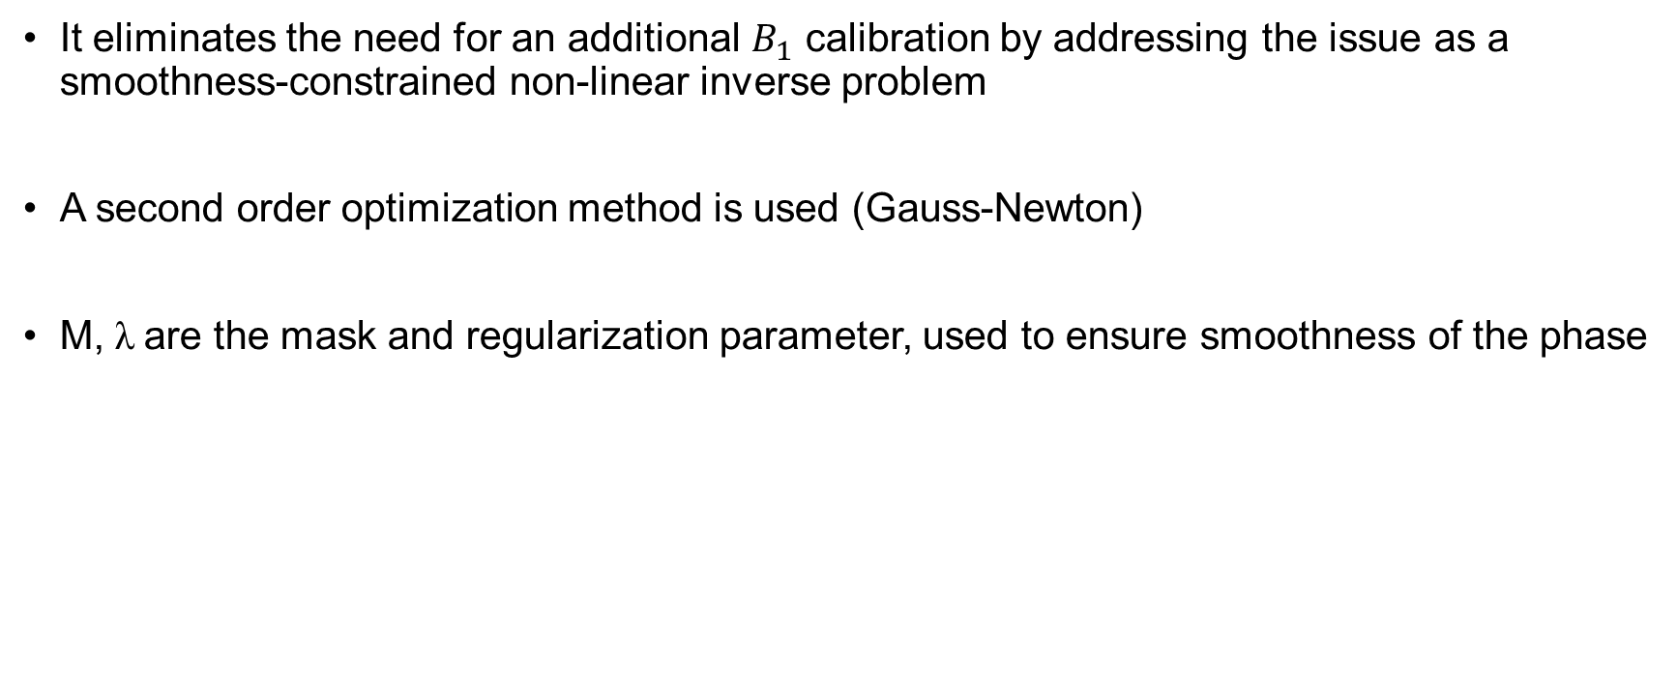
The Optimization Method
It eliminates the need for an additional $B_{1}$ calibration by addressing the issue as a smoothness-constrained non-linear inverse problem
A second order optimization method is used (Gauss-Newton)
M, λ are the mask and regularization parameter, used to ensure smoothness of the phase
$$φ^{∗}= \underset{φ}{argmin}{\frac{1}{2} {\left\|\left(W+Fe^{iΘ\left(TE\right)}\right)e^{iφ}−S_{measured}\right\|}_{2}^{2}+λ{\left\|M∇φ\right\|}_{2}^{2}}$$
Problem is ill posed
Initialization
1. 2022 Kronthaler S, Magn Reson Med.; 87: 1771–1783.
Notes:
To model this phase contributions we use….

Slide 24
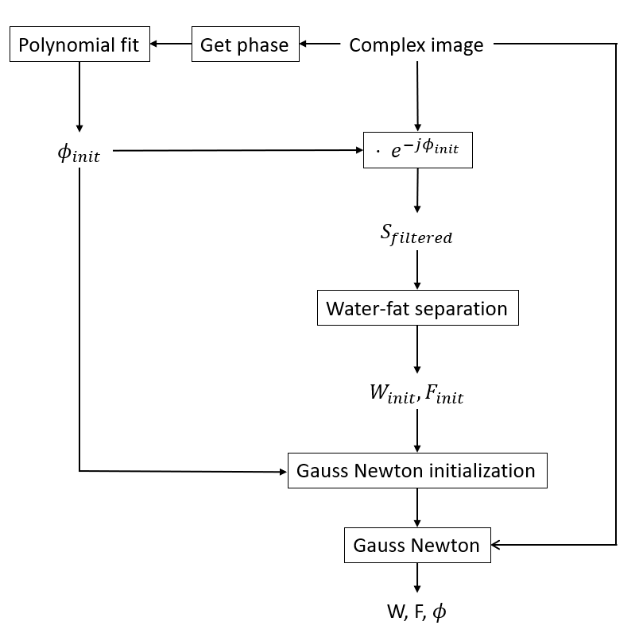
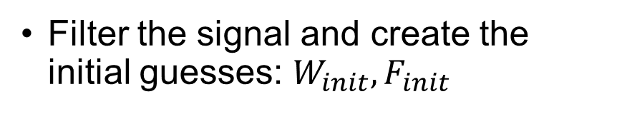
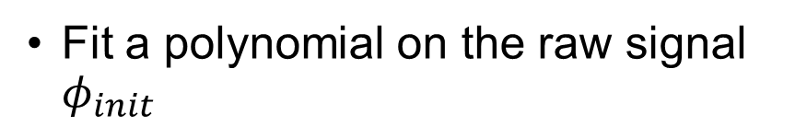
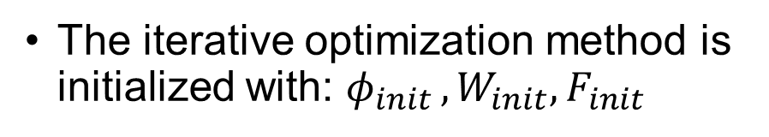
The Algorithm
Fit a polynomial on the raw signal $φ_{init }$
Filter the signal and create the initial guesses: $W_{init}, F_{init}$
The iterative optimization method is initialized with: $φ_{init }, W_{init}, F_{init}$

Slide 25
Separating Water and Fat
Overview
Assessment of the effects of initialization on the Gauss Newton method
Scan Parameters for multiple anatomies
Qualitative comparison of phase fit
Qualitative comparison for water fat separation

Slide 26
Scan Parameters
General parameters:
Sagittal orientation
Flip angle of 5º
SENSE factor of R = 1.5
Specific parameters:
Anatomy | Coil | FOV [mm³] | Resolution [mm³] | TE/TR [ms] | Scan time [min] | W/F-shift [px]
Cervical Spine | Head/Neck coil 20 channels | 220x220x60 | 0.3x0.3x1.5 | 0.4/6.63 | 1:45:0 | 0.65681
Thoracic Spine Anterior | Torso coil + posterior coil 32 channels | 250x250x60 | 0.3x0.3x1.5 | 0.4/6.80 | 2:02:3 | 0.65454
Lumbar Spine | Anterior torso coil + posterior coil 32 channels | 250x250x60 | 0.3x0.3x1.5 | 0.4/6.80 | 2:02:3 | 0.65454

Slide 27
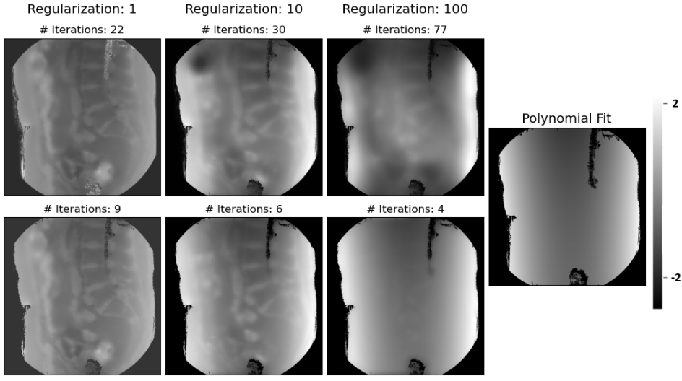
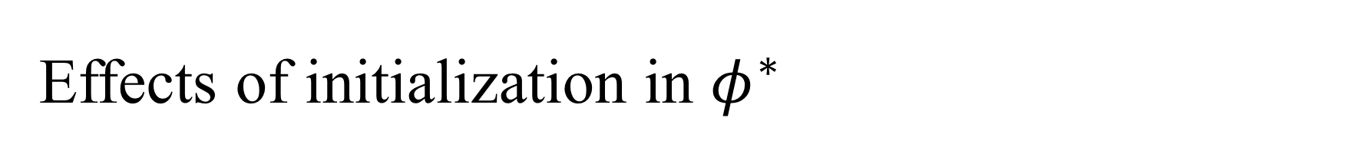
Effects of initialization in $φ^{∗}$
Initialization enforces a smoother final fit
Improved convergence path
Number of iterations till convergence are slightly reduced
No Initialization
With Initialization
↑ Regularization → ↑ Smoothness

Slide 28
Cervical Spine
Water-fat separation quality is enhanced in the cervical spine
Brain and bone separation is improved by the initialization
There are some artifacts at the edges
No Initialization
Water
Fat
With Initialization
No Initialization
With Initialization
No Initialization
With Initialization

Slide 29
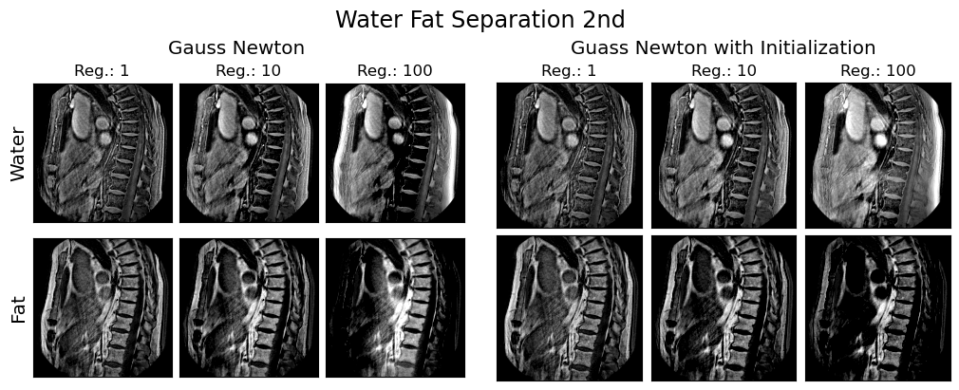
Thoracic Spine
There is no loss of stability by the initialization, visually similar
Better quality at front edge
No Initialization
With Initialization
Fat

Slide 30
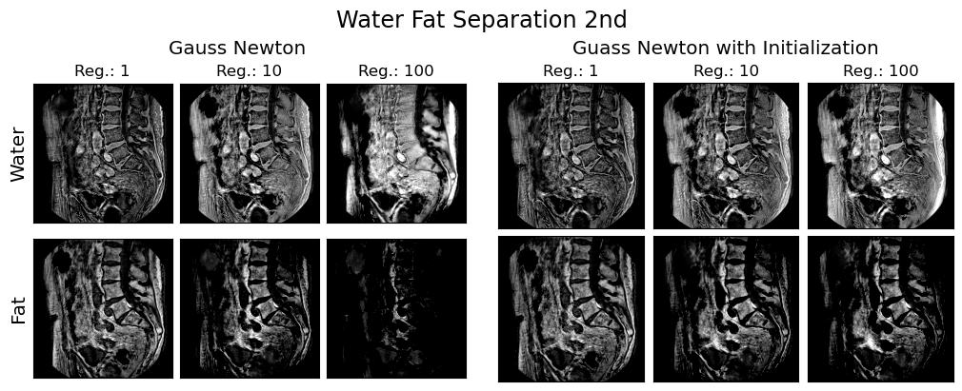
Lumbar Spine
Better robustness when using initialization w.r.t the regularization parameter $λ$
Overall better quality of water-fat separation
Water
Fat
No Initialization
No Initialization
With Initialization
No Initialization
With Initialization
With Initialization
↑ Regularization → ↓ Stability
Regularization ⊥ Stability

Slide 31
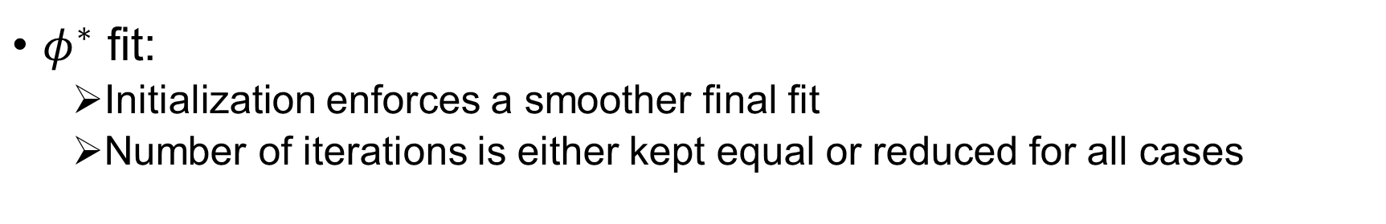
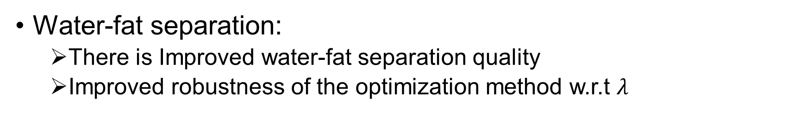
Key Takeaways: Initialization Results
$φ^{∗}$ fit:
Initialization enforces a smoother final fit
Number of iterations is either kept equal or reduced for all cases
Water-fat separation:
There is Improved water-fat separation quality
Improved robustness of the optimization method w.r.t $λ$
Limitations:
Separation quality at the anatomy edges remains to be improved

Slide 32

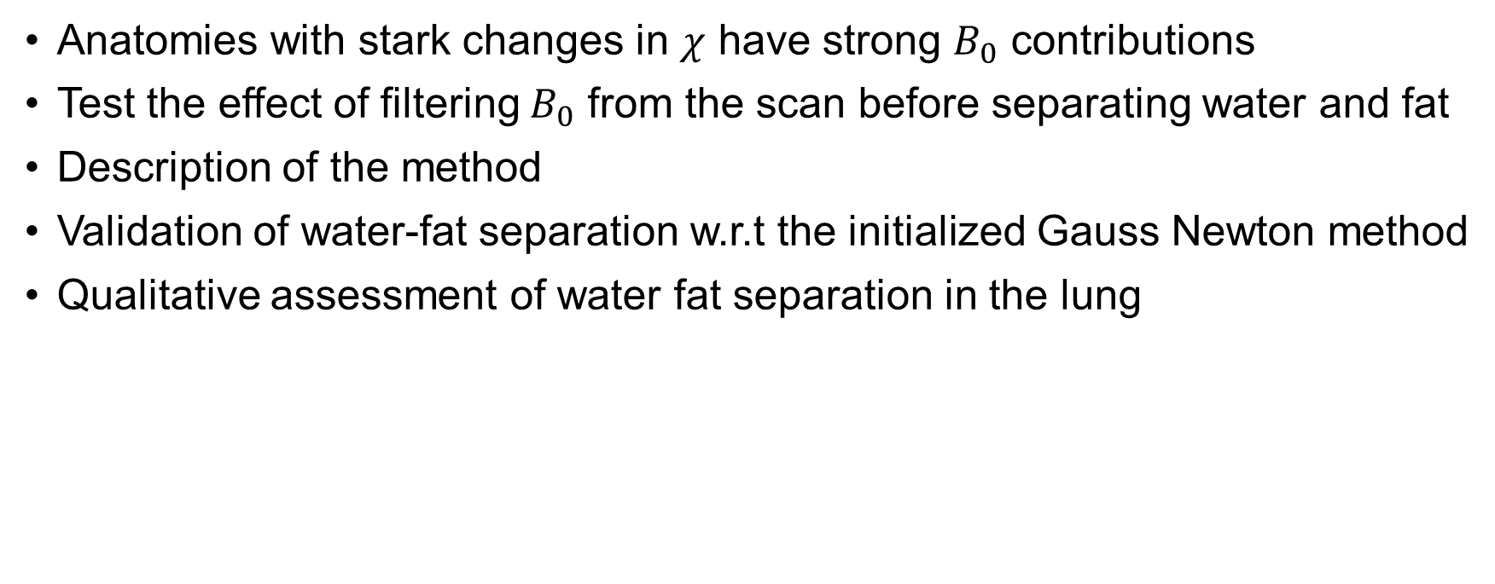
Pre-Initialization Filtering $B_{0}$ effects
Overview
Anatomies with stark changes in $χ$ have strong $B_{0}$ contributions
Test the effect of filtering $B_{0}$ from the scan before separating water and fat
Description of the method
Validation of water-fat separation w.r.t the initialized Gauss Newton method
Qualitative assessment of water fat separation in the lung
Notes:
First we will present the motivation on why do we use sUTE-Dixon. And we will talk about why do we want to model the field inhomogeneities to achieve a better water fat separation quality.

Slide 33


Filtering $B_{0}$ Contributions
Initialization proves to enhance the water-fat separation quality
Anatomies with a strong difference in susceptibility around small regions may be affected significantly by $B_{0}$ contributions
Lung are scanned because of its stark $χ$ difference between tissue and air
The general parameters of the scan are the same as for the previous thoracic spine measurements
Notes:
Short T₂* water and fat signals can be reconstructed from a single UTE complex image. (sUTE Dixon)

Slide 34



The Method
The phase is extracted and masked to only fit the lung
$φ_{B_{0}}$ is modeled and filtered out of the raw signal
$S_{pre−filtered}$ is passed down to the initialized optimization method
Notes:
Short T₂* water and fat signals can be reconstructed from a single UTE complex image. (sUTE Dixon)

Slide 35




Modeling $B_{0}$ inside the Lung
The lungs were scanned with the same parameters as before
The $B_{0}$ map masks only air and not the bronchi
or the heart and spine
$B_{0}$ Map Lung
Lung Scans
Notes:
Short T₂* water and fat signals can be reconstructed from a single UTE complex image. (sUTE Dixon)

Slide 36



Validation
Water-fat separation is virtually equal as with all previous anatomies using the plain initialized Gauss Newton method
Model is validated
Notes:
Short T₂* water and fat signals can be reconstructed from a single UTE complex image. (sUTE Dixon)

Slide 37

Separating Water and Fat: Lung I
Two lungs scans are assessed
Results are similar for medium/high $λ$
At low $λ$ separation is worse at the outer skin fat
Notes:
Short T₂* water and fat signals can be reconstructed from a single UTE complex image. (sUTE Dixon)

Slide 38

Separating Water and Fat: Lung II
Results are similar for high $λ$
At medium/low $λ$ separation is worse at outer skin fat
Notes:
Short T₂* water and fat signals can be reconstructed from a single UTE complex image. (sUTE Dixon)

Slide 39



Key Takeaways: $B_{0}$ Pre-Initialization
Field-Map Fit
Air is correctly captured and modeled inside the lung
Smaller tissues such as bronchi are masked out
Water-fat separation:
Water-fat separation quality is virtually the same in common anatomies
Water-fat separation quality in the lung is decreased at medium/low $λ$
Limitations:
The plain initialized method seems capable of modeling $B_{0}$ without further assistance, leading to overfitting when $B_{0}$ is pre-filtered

Slide 40


Discussion & Conclusion
Modeling field inhomogeneities
$B_{0}$ and $B_{1}$ can be modeled via dipole-kernel and polynomial methods, respectively
$B_{1}$ contributions are more relevant in UTE than $B_{0}$ effects
Initialization of the Gauss Newton method:
Initialization enforces a smoother fit and improves convergence path
Water-fat separation quality, robustness and efficiency is improved
Pre-filtering $B_{0}$:
The plain initialized method seems capable of modeling $B_{0}$ without further assistance, leading to overfitting when $B_{0}$ is pre-filtered

Slide 41




Acknowledgments
The present work was supported by
TUM International Graduate School of Science and Engineering (TUM-ICL Joint Academy of Doctoral Studies)
Philips Healthcare

Slide 42
Thank You

